Slide 1

EDAB 6824 | ASSIGNMENT 3
Bayesian Networks for Heart Disease Prediction
Expert-designed DAG vs a data-driven DAG learned with bnlearn
Lwazi Nhlapo (2021856345)
Boipelo Letwaba
303 patients | 13 predictors | 2 networks
B.Com Hons Business and Financial Analytics | University of the Free State
Notes:
Introduce the team and the question: can routine clinical measurements separate patients with and without heart disease? We compare an expert-designed Bayesian network with one learned from data.

Slide 2






The Problem and the Bayesian Network Workflow
The question: P(disease present | observed clinical evidence)
303
13
Can recorded clinical measurements distinguish patients with heart disease from those without?
Cleveland data: 303 patients, 13 predictors (age, chest pain, thal, ca, exercise-test results...)
Target: heartdisease > 0 recoded to a binary label (139 disease, 164 none)
Goal: compare predictive performance and the explanation each network provides.
patient records
clinical predictors
1. Prepare
2. Structure
3. Parameters
4. Inference
5. Evaluate
6. Compare
Clean, split, discretise
Expert DAG + bnlearn DAG
CPTs via BDeu, ESS 5
Variable elimination
Held-out test set
Accuracy vs interpretability
EDAB 6824 | Bayesian Networks for Heart Disease Prediction
2
Notes:
Explain the prediction problem, why a Bayesian network fits (interpretable, probabilistic, evidence can flow in any direction) and walk through the six workflow stages that structure the rest of the talk.

Slide 3
Data Collection and Preparation
242 / 61
6
train / test split
missing cells (ca 4, thal 2)
45.9%
0
disease prevalence
duplicate rows
Pipeline decisions
Missing: training median (continuous) or mode (categorical); no rows dropped
Leakage: original 0-4 outcome removed from predictors; target is heartdisease_bin
Discretisation: age, BP, chol, thalach into training tertiles (Low/Med/High); oldpeak: 0 = No depression, then split at the median
Balance: moderate imbalance only, so we report recall and precision, not just accuracy
EDAB 6824 | Bayesian Networks for Heart Disease Prediction
3
Notes:
Data verified: 303 rows, 14 columns, no duplicates. Only 6 missing cells (4 in ca, 2 in thal), imputed from training data only. Split is stratified 80/20 so class balance is preserved; disease prevalence is 45.9% in all sets so no oversampling was needed. Discretisation uses training tertiles, frozen and reused on the test set, so the pipeline is reproducible.

Slide 4
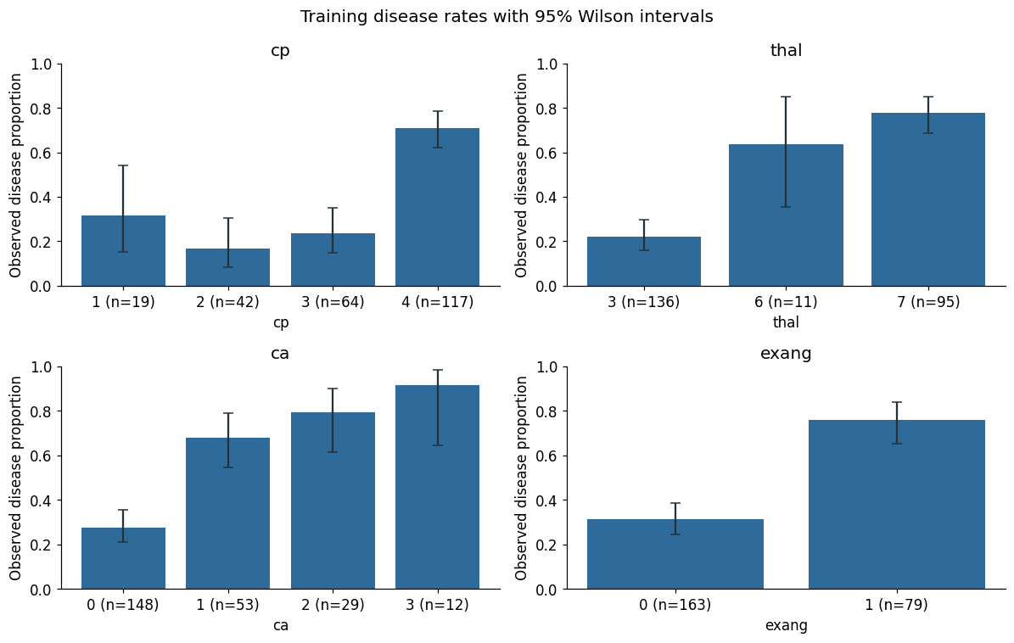
Exploratory Analysis: What Separates the Groups?
Bars show observed disease proportion with 95% Wilson intervals. These are unadjusted associations, not causal effects.
Strongest: thal, cp, ca. Weakest: fbs, BP, chol.
EDAB 6824 | Bayesian Networks for Heart Disease Prediction
4
Notes:
EDA on training data only. Disease rates rise sharply for cp=4 (asymptomatic), thal=7, more vessels coloured (ca) and exercise angina. Mutual information ranks thal, cp and ca as the most informative predictors; fasting blood sugar, blood pressure and cholesterol carry almost no univariate signal, which is why feature selection was not needed but sparse CPTs are a risk.

Slide 5
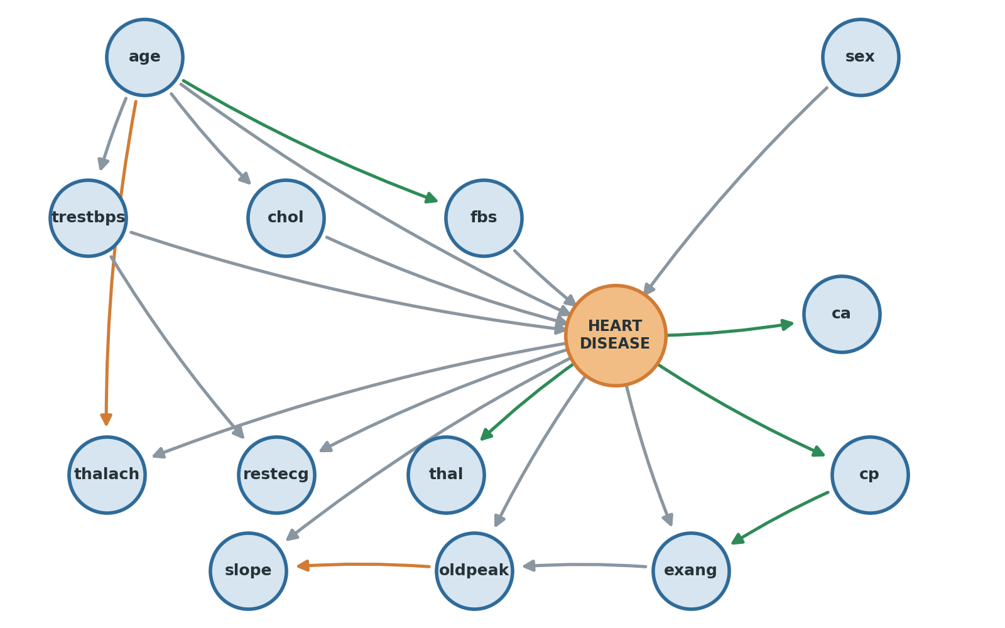
Expert DAG: Clinical Knowledge as a Graph
Main pathways into disease
1. Risk factors: age, sex, blood pressure, cholesterol and fasting glucose feed disease (5 arrows)
2. Age effects: age also shapes BP, cholesterol, glucose and max heart rate
3. Findings: disease drives thal, ca, cp, exang, ST depression, slope, thalach and ECG (8 arrows)
4. Chains: cp to exang to oldpeak to slope link related exercise findings
21 arrows
5 target parents & 8 target children
green = also learned, orange = reversed when learned, grey = expert only
EDAB 6824 | Bayesian Networks for Heart Disease Prediction
5
Notes:
Walk the three reasoning pathways into and out of the target. The 21 arrows are modelling assumptions grounded in clinical logic, not proven causal claims. Green arrows are shared with the learned DAG, orange are reversed in the learned DAG.

Slide 6
Expert DAG: Justification for Every Edge
Edge(s) | Why the parent plausibly influences the child
age to trestbps, fbs, chol (3) | Blood pressure, glucose and cholesterol distributions vary with age; fbs is a glucose indicator, not a diabetes diagnosis
age to thalach (1) | Maximum achievable heart rate declines with age (Tanaka et al., 2001)
age, sex, trestbps, chol, fbs to disease (5) | Baseline cardiovascular risk information; sex allows different baseline disease distributions
trestbps to restecg; disease to restecg (2) | Resting ECG can show hypertrophy linked to blood pressure; ECG findings differ by disease status
disease to thal, ca (2) | Perfusion scan and fluoroscopy are diagnostic investigations of disease
disease to cp, exang, oldpeak, slope, thalach (5) | Symptoms and exercise-test responses are disease-conditioned findings
cp to exang; exang to oldpeak; oldpeak to slope (3) | Related symptoms and ECG summaries of the same exercise response; direction is a factorisation choice
These arrows encode a clinical story, not proven causation.
EDAB 6824 | Bayesian Networks for Heart Disease Prediction
6
Notes:
All 21 edges are justified, grouped by shared reasoning. Cite Tanaka et al. (2001) for the age and max heart rate link and Detrano et al. (1989) for combining clinical and test information. The arrows are assumptions; observational data cannot prove causality.

Slide 7
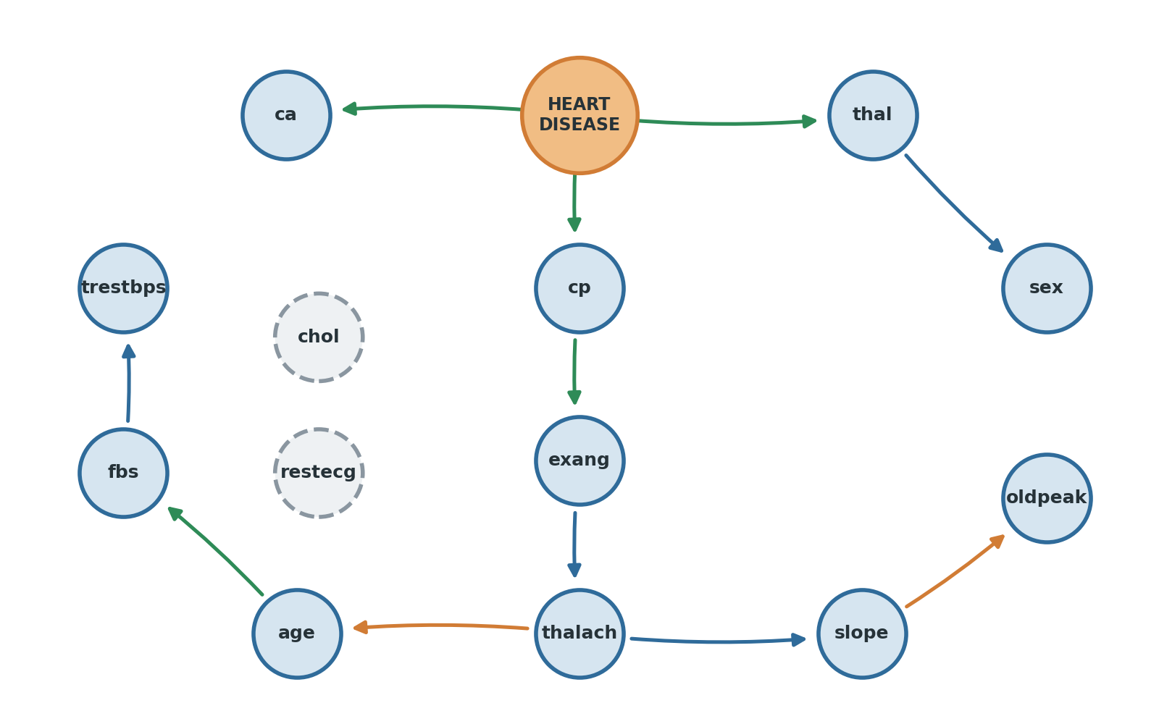
bnlearn DAG: Structure Learned from Data
Settings and why
Hill climbing: greedy add/remove/reverse of arrows
BIC score: rewards fit, penalises parameters (n = 242)
Empty start, no constraints: the data alone decide
Tabu 100, tol 1e-4, 10,000 iters: inspectable limits
Training data only: test labels never used
Isolated nodes
Result: target Markov blanket = cp, thal, ca
14 nodes, 11 arrows | green = also in expert, orange = reversed vs expert, blue = learned only
EDAB 6824 | Bayesian Networks for Heart Disease Prediction
7
Notes:
We use hill climbing with the BIC score, starting from an empty graph with no forced directions. BIC penalises complexity, which matters with only 242 training rows. The result is sparse: 11 arrows, chol and restecg isolated, and the target has no parents so it is a root node. Its Markov blanket is only cp, thal and ca.

Slide 8
Comparing the Expert and Learned DAGs
5
2
14
4
common edges
reversed pairs
expert only
learned only
What the graphs share and differ on
Strange relationships and blankets
Common: age to fbs, cp to exang, disease to ca, cp, thal
Reversed: age/thalach and oldpeak/slope (direction is arbitrary for related measures)
Expert only: age, sex, BP, chol, fbs into disease; disease to exang, oldpeak, slope, thalach, restecg
Learned only: exang to thalach, fbs to trestbps, thal to sex, thalach to slope
thal to sex, thalach to age: tests cannot cause age or sex; these are statistical factorisations only
Markov blanket: 13 variables (expert) vs 3 (learned)
Implication: learned model ignores nine predictors once cp, thal, ca are known, so many profiles tie
Isolated nodes: chol and restecg have no learned arrows
EDAB 6824 | Bayesian Networks for Heart Disease Prediction
8
Notes:
Only five arrows are shared, all involving the disease node or its neighbours. The learned graph drops most risk-factor arrows into disease because BIC finds them too weak given 242 rows. Two learned arrows point into age and sex, which cannot be caused by test results; they are statistical factorisations, so we do not read the learned graph causally.

Slide 9
Parameter Learning: CPTs for Both Networks
How the CPTs were estimated
Complexity | Expert | Learned
Edges | 21 | 11
Free parameters | 194 | 57
Target parent configs | 108 | 1
Configs never observed | 39 | 0
Configs with n < 5 | 93 | 0
BDeu prior: uniform Dirichlet, ESS = 5 spread across each CPT
Unseen parent sets get a uniform distribution, an assumption not evidence
All 14 nodes per network keep a CPT (isolated nodes included)
Validated: columns sum to 1, probabilities positive and finite
The expert target CPT is large and sparse; the learned target is a single prior row (46.0% disease, n = 242).
EDAB 6824 | Bayesian Networks for Heart Disease Prediction
9
Notes:
Parameters are estimated on training data only using a BDeu prior with equivalent sample size 5. Every node in each network has a valid CPT: 14 per model, 28 in total, all checked to sum to one and exported to CSV. The expert target CPT has 108 parent configurations and 39 of them are never observed, so those 50% entries come from the prior, not from patients. Fitted networks are saved as .pkl files.

Slide 10
Target CPT: Five Informative Patterns
# | Expert parent configuration (sex, fbs, age, BP, chol) | n | P(disease) | vs 45.9%
1 | Male, fbs 0, age High, BP High, chol High | 5 | 99.5% | +53.7 pp
2 | Male, fbs 0, age High, BP Low, chol Medium | 5 | 99.5% | +53.7 pp
3 | Male, fbs 0, age Medium, BP High, chol High | 9 | 88.7% | +42.8 pp
4 | Male, fbs 0, age Low, BP Medium, chol Low | 6 | 0.4% | -45.5 pp
5 | Female, fbs 0, age Low, BP Low, chol Low | 9 | 0.3% | -45.6 pp
Reading the pattern
Caution
Older males with elevated BP and cholesterol have very high modelled risk; young, low-risk profiles have near-zero risk. Risk stacks across factors.
Rows rest on 5 to 9 patients each, and 39 of 108 configurations were never seen. Learned target: single prior of 46.0% (n = 242).
EDAB 6824 | Bayesian Networks for Heart Disease Prediction
10
Notes:
Read the expert target CPT rows. Each row is P(disease=1 | age, sex, BP, chol, fbs). These are the highest and lowest supported rows compared with 45.9% prevalence. Support is only 5 to 9 patients per row, so treat them as descriptive. In the learned network the target has no parents, so its CPT is a single prior of 46.0%.

Slide 11
CPTs of Disease-Conditioned Findings
Asymptomatic chest pain (cp 4): 73.7% of disease cases vs 25.9% without
Reversible thal defect (7): 65.9% vs 16.4%
No coloured vessels (ca 0): only 36.7% of disease cases vs 80.6%
Exercise angina: 54.0% vs 15.2% (expert), 44.0% vs 23.6% (learned)
Target prior: 46.0% before any evidence
EDAB 6824 | Bayesian Networks for Heart Disease Prediction
11
Notes:
These CPTs are P(finding | disease), shared by both networks for cp, thal and ca because they have the same target-only parent. Exercise angina differs: the expert model conditions it on disease and chest pain, the learned model reaches it through chest pain only. Remind the audience that P(finding | disease) is not P(disease | finding).

Slide 12
Inference: Highest and Lowest Risk Profiles
Model | Extreme | Profile (sex, cp, exang, thal, ST, HR, slope, ca) | P(disease) | Train n
Expert | Highest | Male, cp 4, exang 1, thal 7, High ST, Low HR, flat, ca 3 | 99.96% | 1
Expert | Lowest | Female, cp 2, exang 1, thal 3, No ST, High HR, down, ca 0 | 0.05% | 0
Learned | Highest | Female, cp 4, thal 7, ca 3 (any values of the rest: ties) | 98.79% | 0
Learned | Lowest | Female, cp 2, thal 3, ca 0 (any values of the rest: ties) | 3.20% | 1
Answer
Best observed profile (expert)
Highest: reversible thal defect, asymptomatic chest pain and 3 vessels. Lowest: normal thal, atypical chest pain and 0 vessels.
Male, cp 4, exang 1, thal 7, High ST, Low HR, flat slope, ca 2: 99.93% with 7 training patients.
EDAB 6824 | Bayesian Networks for Heart Disease Prediction
12
Notes:
We ran variable elimination over all 5,184 combinations of sex, cp, exang, thal, oldpeak, thalach, slope and ca in both networks; 176 combinations occur in training. Expert extremes are more extreme (99.96% and 0.05%) because its target CPT has many parents. The learned model saturates at 98.8% for any profile with cp=4, thal=7, ca=3.

Slide 13
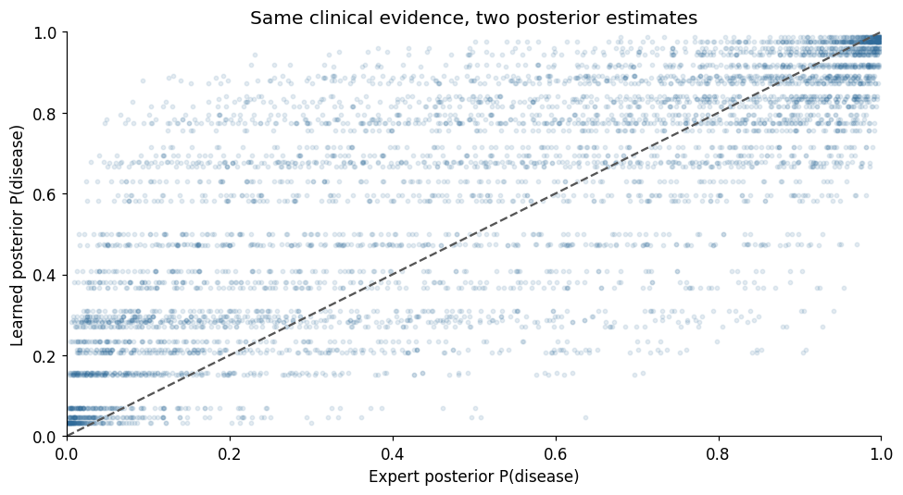
Ranked Combinations and Model Agreement
Rank | Expert profile (sex 1, cp 4, exang 1, thal 7 +) | P(D) | n
1 | High ST, Low HR, slope 2, ca 3 | 99.96% | 1
2 | High ST, Low HR, slope 2, ca 2 | 99.93% | 7
3 | High ST, Low HR, slope 2, ca 1 | 99.88% | 4
4 | Moderate ST, Low HR, slope 2, ca 1 | 99.78% | 4
5 | High ST, Low HR, slope 1, ca 3 | 99.77% | 1
Each dot is one of 5,184 evidence profiles.
Learned model ranking
Top observed profiles all tie at 98.79% because only cp, thal and ca matter: cp 4, thal 7, ca 3.
EDAB 6824 | Bayesian Networks for Heart Disease Prediction
13
Notes:
Ranked table shows the top observed combinations in the expert model, all male, cp 4, exang 1, thal 7 with low heart rate and high ST depression. For the learned model, every profile with cp=4, thal=7, ca=3 ties at 98.79%. The scatter compares both posteriors for the same evidence across all 5,184 profiles; the models agree in direction but the learned model is flatter.

Slide 14
Changing One Variable and Reverse Inference
Given disease = 1 | Most probable state | Expert | Learned
cp | 4 (asymptomatic) | 73.7% | 73.7%
thal | 7 (reversible) | 65.9% | 65.9%
exang | Expert 1 / Learned 0 | 54.0% | 56.0%
ca | 0 vessels (ca > 0: 63.3%) | 36.7% | 36.7%
Reverse inference: P(finding | disease). The two models agree on cp, thal and ca because these share the same target-only parent. They differ only on exercise angina.
Expert +15.7 pp, learned +34.7 pp. Other single changes move the posterior far less; the learned model is blind to variables outside its blanket.
EDAB 6824 | Bayesian Networks for Heart Disease Prediction
14
Notes:
Baseline is the most common profile in training (male, cp 2, exang 0, thal 3, no ST depression, high heart rate, slope 1, ca 0; n = 7). Changing ca from 0 to 3 gives the largest jump in both models, from 1.1 to 16.8 in the expert model and 3.2 to 37.9 in the learned model. Reverse inference conditions on disease = 1 and reads off the likely findings.

Slide 15
Are the Inference Results Reasonable?
Reasonable
Sensitivity: P(disease) by ESS | 1 | 5 | 10
Expert, its high profile | 99.98% | 99.96% | 99.95%
Expert, its low profile | 0.002% | 0.05% | 0.15%
Learned, its high profile | 99.2% | 98.8% | 98.4%
Learned, its low profile | 2.99% | 3.20% | 3.47%
Reversible defects, more vessels and exercise angina raise risk in both models
Both agree on the direction of every finding
cp 4 predicts disease here because this is a selected clinical sample, not the general population
Reverse and forward probabilities differ (ca 0 is common in disease, yet ca 3 is riskier)
Robustness
Expert posteriors move by up to 9.45 pp under different smoothing; learned by only 0.80 pp. Extreme values on unsupported profiles are not certainty.
EDAB 6824 | Bayesian Networks for Heart Disease Prediction
15
Notes:
Direction is clinically sensible in both networks. Two cautions: cp=4 means asymptomatic and strongly predicts disease only in this selected clinical sample, and extreme expert probabilities rest on sparse data. Smoothing sensitivity shows the expert model varies up to 9.45 pp across ESS 1, 5, 10 while the learned model varies 0.8 pp.

Slide 16
Model Evaluation on the Held-Out Test Set
Metric | Expert | Learned
Accuracy | 85.2% | 86.9%
Precision | 80.6% | 85.7%
Recall | 89.3% | 85.7%
Specificity | 81.8% | 87.9%
F1-score | 0.847 | 0.857
ROC-AUC | 0.939 | 0.918
Avg precision | 0.934 | 0.914
Brier (lower better) | 0.105 | 0.108
Expert
Pred: No
Pred: Yes
Actual: No
27
TN
6
FP
3 missed cases, 6 false alarms
Actual: Yes
3
FN
25
TP
Learned
Pred: No
Pred: Yes
Actual: No
29
TN
4
FP
4 missed cases, 4 false alarms
Baseline (no disease for all): accuracy 54.1%, AUC 0.50
Actual: Yes
4
FN
24
TP
Expert detects 25 of 28 disease cases. Learned correctly rejects 29 of 33 non-disease cases.
EDAB 6824 | Bayesian Networks for Heart Disease Prediction
16
Notes:
Test set of 61 patients (28 disease), threshold 0.50 fixed in advance. The learned model wins on accuracy, precision, specificity and F1; the expert model wins on recall (misses 3 rather than 4 cases), ROC-AUC, AP and Brier score. Both far outperform the majority-class baseline (54.1% accuracy, AUC 0.50).

Slide 17
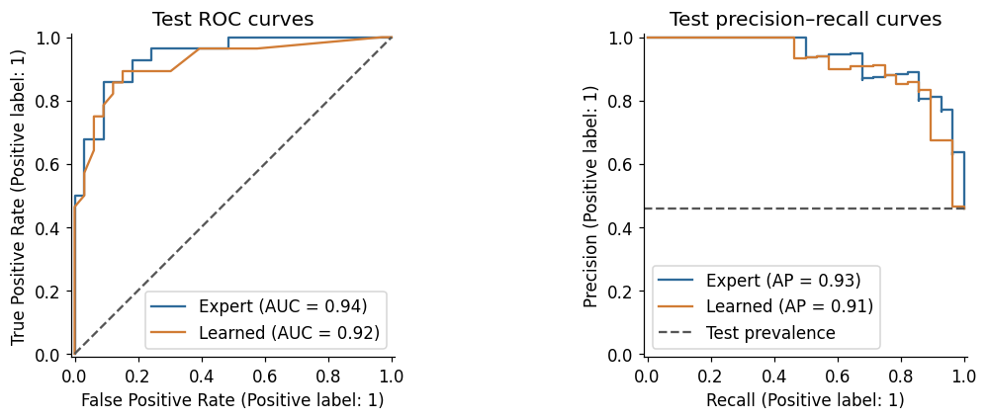
Ranking Quality and Uncertainty
-0.021
learned minus expert ROC-AUC
Paired bootstrap 95% CI
[-0.098, +0.039] includes zero: no reliable ranking advantage.
Both AUCs are high (0.94 and 0.92), so posterior probabilities rank patients well. Expert leads on point estimates of AUC, AP and Brier; learned leads on threshold metrics. The 61-patient test set cannot separate them.
EDAB 6824 | Bayesian Networks for Heart Disease Prediction
17
Notes:
ROC and precision-recall curves overlap heavily. The paired bootstrap of the test patients gives a learned minus expert AUC difference of minus 0.021 with a 95% interval from minus 0.098 to plus 0.039, which includes zero, so neither model is shown to be superior on ranking. With only 61 test patients the estimates are imprecise and this is not external validation.

Slide 18
Conclusion: Performance vs Interpretability
Expert DAG
Learned DAG
Higher ROC-AUC (0.939), AP, recall
Clear clinical story
But 194 parameters and 39 unseen configurations
Higher accuracy (86.9%), precision, F1
Only 57 parameters, stable to smoothing
But arrows into age and sex are not clinically credible
Verdict and recommendations
Expert DAG is preferred on the stated primary metric, but the difference is not conclusive (CI includes zero)
Best model is not the most interpretable: use the expert graph for explanation and the learned graph as a data check
Resample preprocessing, structure learning and CPT fitting within training data.
Retrain without ca and other unavailable tests for any proposed pre-test setting.
Evaluate independent patients and assess probability calibration.
Compare alternative discretisation and missing-data approaches without tuning on the test set.
Limits: one small selected sample, discretisation, mode imputation and one train/test split; no treatment or deployment recommendation
Notes:
Answer the rubric question directly: expert DAG is preferred by the pre-specified ranking metric (ROC-AUC) but not conclusively; the learned DAG is far simpler with 57 vs 194 parameters and better balanced at the threshold, but contains implausible arrows. The best predictor is therefore not automatically the most interpretable. Recommendations are validation steps; we make no deployment claim.

Slide 19

References
`EDAB6808_Assignment3.pdf` (instructions and both rubrics)
`Data/diabetes.csv` (all empirical results);
Dataset definitions: [UCI Heart Disease](https://archive.ics.uci.edu/dataset/45/heart+disease).
Method documentation: [Python bnlearn structure-learning source](https://github.com/erdogant/bnlearn/blob/master/bnlearn/structure_learning.py) and [pgmpy BayesianEstimator](https://pgmpy.org/_modules/pgmpy/estimators/BayesianEstimator.html).
Arnett, D.K., Blumenthal, R.S., Albert, M.A., Buroker, A.B., Goldberger, Z.D., Hahn, E.J., Himmelfarb, C.D., Khera, A., Lloyd-Jones, D., McEvoy, J.W., Michos, E.D., Miedema, M.D., Muñoz, D., Smith, S.C. Jr, Virani, S.S., Williams, K.A. Sr, Yeboah, J. and Ziaeian, B. (2019) ‘2019 ACC/AHA guideline on the primary prevention of cardiovascular disease: A report of the American College of Cardiology/American Heart Association Task Force on Clinical Practice Guidelines’, Circulation, 140(11), pp. e596–e646. doi: 10.1161/CIR.0000000000000678.
Detrano, R., Janosi, A., Steinbrunn, W., Pfisterer, M., Schmid, J.J., Sandhu, S., Guppy, K.H., Lee, S. and Froelicher, V. (1989) ‘International application of a new probability algorithm for the diagnosis of coronary artery disease’, The American Journal of Cardiology, 64(5), pp. 304–310. doi: 10.1016/0002-9149(89)90524-9.
Janosi, A., Steinbrunn, W., Pfisterer, M. and Detrano, R. (1989) Heart disease [Dataset]. UCI Machine Learning Repository. doi: 10.24432/C52P4X.
pgmpy developers (n.d.) pgmpy.estimators.BayesianEstimator [Software documentation and source code]. Available at: BayesianEstimator documentation (Accessed: 26 September 2026).
Tanaka, H., Monahan, K.D. and Seals, D.R. (2001) ‘Age-predicted maximal heart rate revisited’, Journal of the American College of Cardiology, 37(1), pp. 153–156. doi: 10.1016/S0735-1097(00)01054-8.
Questions and discussion
Lwazi Nhlapo (2021856345)
Boipelo Letwaba (2024053890)
Notes:
Close by thanking the audience and inviting questions. Both members should present: one on data, structure and CPTs, the other on inference, evaluation and conclusions.

